Slide 1
HOPHACKS 2026
iCane
A phone, a clamp, and the cane you already have.
Tanmay · Abhishek · Yakshil · Abigail

Slide 2


A cane only sees what it touches.
Overhead alert!
Blind to the side
A stick on the ground can't warn you about a low overhang at head height.
Someone can walk straight into you after your cane has already cleared the space ahead.

Slide 3

People with visual impairments face a higher risk of serious life events.
Especially traffic-related accidents.
Source: National Institutes of Health
Notes:
Have website pulled up

Slide 4

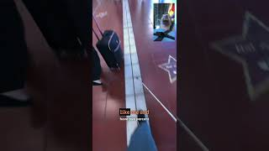
What that looks like in real life
No situational awareness
Reliance on tactile lines that others disrespect
From @twoblindbrothers on Instagram
From Mr. Blind Life on YouTube

Slide 5



All we need is a phone and a clamp.
Clamp it on
Watches ahead
Hear changes
Any phone, any cane. Nothing custom to build or buy.
The camera scans continuously and AI vision flags hazards.
Alerts only when something new appears, so it never turns into noise.
Plus: tap anytime to ask what's in the scene.

Slide 6



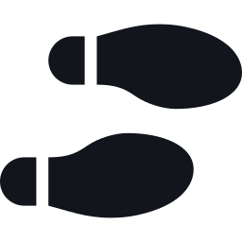


Live demo: what you'll hear
Static object
Person approaching
Stairs and curbs
Low overhang
Calls it out once, with direction.
Warns as they close in, even from the side.
Flags the drop before you step.
Catches what the cane can't reach.
Door location
Floor clutter
Nothing
Tap and ask
Tells you where the door is.
Calls out items on the ground.
Stays quiet.
Describes the full scene on demand.

Slide 7
Why not what exists today?
Be My Eyes
WeWALK Smart Cane
Walk-Assist Cane
Needs a human
$799 to $1,249
Phone + clamp
Depends on an available person
High latency due to the live call function
Newest model: $799
With AI included: up to $1,249 total
Cheaper earlier model no longer offered on the official site
Always on, with no one to call
Uses the phone you already own
Hands-free hazard alerts

Slide 8



Where we take it next
Know how far
Navigation
Personalization
Depth sensing now gives an estimate for how far an obstacle is.
Street crossings, traffic signals, and route guidance.
Adjustable voice, sensitivity, and vibration cues.
First step: test and co-design with blind and low-vision users.

Slide 9
The cane only tells you
what it touches.
Now it can tell you
what's ahead.
Thank you. Questions?
Tanmay · Abhishek · Yakshil · Abigail

